Slide 1
MCAS Test Administration and Security Protocols for Returning Staff
Note: This training session will be geared toward returning staff.
New test coordinators may want to register for the February 2 training session for new staff -- www.doe.mass.edu/mcas/training.html.
The Office of Student Assessment Services
January 31, 2024

Slide 2
Presenters
Shannon Cullen, Test Administration Coordinator
Robert Pelychaty, Manager of Inclusive Assessment
David Ragsdale, Test Security Specialist

Slide 3
Logistics for This Session
Use the Q&A feature to ask a question.
  We will answer some questions aloud at specified times during this training session, and we will email the Q&A afterwards.
  Type your questions anytime, but we may not answer them in real time as some questions may be covered during the presentation.
  Use the thumbs-up icon to “upvote” someone else’s question.
  Email student-specific questions to MCAS@mass.gov instead of asking here.
This session is being recorded and will be available in about a week in the MCAS Resource Center, along with the slides.
  Slides were also emailed out beforehand, and are being posted in the chat.
Closed captioning has been enabled for participants who need it.

Slide 4
Slides for This Session
Slides were emailed to participants before this session from MCASEvents@cognia.org.
Slides are now being posted in the chat.
  If you cannot access the slides in the chat, ask in the Q&A.
After the session, we will send the slides again to participants, and they will be posted in the MCAS Resource Center along with the recording.

Slide 5
Today’s Agenda
Updates for 2024
Test Administration Protocols
Test Security Requirements
Accessibility and Accommodations
Resources, Support, and Next Steps
Protocols for Paper-Based Testing (PBT)
Additional Information for High Schools

Slide 6
Poll Question
How many years have you coordinated MCAS test administration at your school or district?
  6 or more years
  3 to 5 years
  1 to 2 years
  This is my first year.

Slide 7
1. Updates for 2024

Slide 8
Test Administration Resources for 2024
www.doe.mass.edu/mcas/testadmin
  Spring 2024 test administration manuals now available!
  MCAS Pre-Administration Guide

Slide 9
Updates for 2024
Topic | General Information
Testing Schedule | Grades 5 and 8 STE testing window opens on the same day as grades 3–8 Math; when possible, Math should be administered first.
PearsonAccess Next (PAN) and TestNav | Updates to TestNav system requirements and updates to TestNav and PearsonAccess Next Student Tutorial Table of Contents available; can be helpful for schools that will not use all of the features in TestNav or want to focus on a particular topic
Test Security and Administration Protocols | Testing irregularities involving electronic devices after students complete testing and submit their tests no longer need to be reported to DESE (Note: Test administrators still need to report all irregularities to their principals, and principals may contact DESE with questions.)

Slide 10
Updates for 2024 (cont’d)
Topic | General Information
Accessibility and Accommodations | Appendix C of the PAM includes a list of the accessibility features and accommodations that are collected in the SR/PNP Universal Accessibility Features UF2 (Color contrast) and UF6 (Answer masking) now available in TestNav to all students (no longer collected in SR/PNP) Spanish/English translation of TestNav interface available for students taking grade 10 Math and high school Science New Appendix A for the SR/PNP Guide with guidance on form-dependent accommodations (TTS, ASL, Spanish/English, screen reader, compatible assistive technology) New prompts when signing in with a proctor testing ticket Text-to-speech (TTS) different for Civics than other tests
PBT Procedures | Student ID Labels are to be applied to students’ booklets by staff members instead of students.
High School Participation Guidelines | Now included in the PAM

Slide 11
2. Test Administration Protocols

Slide 12
General Timeline for MCAS CBT
Pre-Administration Tasks
Beginning in Fall 2023
(Ongoing) Read biweekly Student Assessment Updates.
At least 2 months before testing
Update user accounts
in PAN and create additional accounts.
At least 2 weeks before testing
Run App Check and conduct an Infrastructure Trial and/or Preliminary System Test.
Prepare students for online testing.
Become familiar with CBT components.
Identify the school test administration team.
Update contact info with DESE.
View online modules and participate in training sessions.
Meet with the technology coordinator, who will review the tech specs and prepare the school’s infrastructure.
Review instructions in the Principal’s Administration Manual.
Complete the SR/PNP.
Plan for accessibility features and accommodations.
Prepare devices and materials.
Delivered to schools 2 weeks before spring ELA, and one week before each fall/winter administration. Available online beforehand.
Train test administrators in protocols and security requirements.
Establish a communication plan with the test administration team.

Slide 13
Computer-Based Testing Components
Re-familiarize yourself with the following components of CBT:
  PearsonAccess Next: Online test management system
    Brown training site and blue live site
    View the PAN Overview video
    To do now: Create and update PAN users
  TestNav: Student testing platform
View the January 17 “Introduction to CBT” training session recording.
    Walk-through of tasks to complete before testing in the fall, two months before testing, and up to two weeks before testing
Offer your expertise to new staff at your school or in your district.

Slide 14
Identify Your Test Administration Team
Meet with the technology coordinator and begin technology preparations.
Consider assignments for test administrators.
Develop your communication plan for technology and administration.
Update contact information with DESE and in PearsonAccess Next as needed.
  See the January 3 Student Assessment Update for guidance on updating PAN accounts.
  Can subscribe to the Student Assessment Update at http://eepurl.com/ghSOhH

Slide 15
Update Student Information
In SIMS (DESE Student Information Management System)
In the SR/PNP (Student Registration/
Personal Needs Profile) in PAN
Go to profiles.doe.mass.edu/search/search.aspx?leftNavID=11239, select SIMS Contact from the Function menu, and click Get Results
Data source: School Interoperability Framework (SIF) for the SR/PNP for districts that use SIF (October SIMS for non-SIF districts)
Pre-administration deadlines for PBT test materials and CBT/PBT manuals are as follows:
  February 2 for the March retests
  February 2 for grades 3–8
  February 9 for grade 10 ELA and Mathematics
  April 5 for the grade 8 Civics field test
  April 30 for High school Science
See the January 16 Student Assessment Update and the SR/PNP webpage for guidance on the SR/PNP.

Slide 16
Identify “Who,” “Where,” and “When”
Particularly for high schools, identify all students participating in each grade’s tests.
  High school participation guidelines now available
Assign accessibility features and accommodations.
  Plan for where accommodations will be administered
  (e.g., students with a one-to-one administration).
Establish testing locations and develop staffing plans.
  Prepare list of test administrators and students for school records, and assign/update user roles in PAN (details on upcoming slide).
  Begin training plans for test administrators and staff; train at least 2 weeks before testing.
  Slide template (to be updated by mid-Feb.) – www.doe.mass.edu/mcas/testadmin
  Plan for secure testing environments.

Slide 17

Test Admin Workgroup Input: “How long are your school’s test sessions, and what are the plans for students who need extended time?”
Knowing that the students have until the end of the day, we use a “majority done” time of 11:15 a.m. before we send students to “over-time” rooms.
Testing starts around 8:15 a.m., so the students have about 3 hours to test.
At 11:15 a.m., students (along with their computers, after they log out, and their testing tickets) are escorted to specific rooms where they can test until the end of the school day.

Slide 18
Poll Question
How does your school schedule test sessions?
  All students have one session that lasts all day.
  Most students finish in less than 2 hours.
  Most students finish in 2 to 3 hours.
  Most students take more than 3 hours to finish.
  Something else

Slide 19
Scheduling Considerations
TestNav will be available between 7:00 a.m. and 4:00 p.m., Monday–Friday, except the week of April school vacation; request special access to test outside these hours (see PAM page 29).
Grades 4 and 10 Math, and grades 5 and 8 STE:
  Decide whether to administer the optional questionnaire directly after Session 2 or another time.
Plan logistics related to scheduling.
  One break per session, around 3–5 minutes, at test administrator’s discretion.
  Make plans for students who finish early and students who need extra time, including students who work through lunch; consider using dismissal waves.
If needed for efficiency, can group students taking the same test together for make-up testing, if the TAM script matches.
  Grades 3–8 ELA, gr. 3 & 4 Math, gr. 5 & 6 Math, gr. 7 & 8 Math, gr. 5 & 8 STE
  Do not group together students doing CBT and any students doing PBT.

Slide 20
Delivery Dates for Manuals and PBT Materials
Grades 3–8:
  March 11: Receive all manuals, and ELA PBT materials
  April 9: Receive Math/STE PBT materials
Grade 10:
  March 12: Receive manuals for ELA and Math, and ELA PBT materials
  May 7: Receive Math PBT materials
High School Science:
  May 21: Receive manuals and PBT materials

Slide 21
Poll Question
Where do you work?
  At an elementary school
  At a middle school
  At a combined middle/high school
  At a high school
  At a district office
  Other

Slide 22
2024 Grades 3–8 Administration Schedule
ELA testing window | March 25–April 26 (Note that ELA will be administered earlier than Mathematics and STE.)
Mathematics testing window | April 23–May 24
STE testing window (grades 5 and 8) | April 23–May 24
Grade 8 Civics field test window | April 29–June 7
These testing windows include all make-up testing.
The sequence for administering tests should be as follows, when possible
  first ELA
  followed by Mathematics
  followed by STE
  Civics can be administered at any time between April 29 and June 7.

Slide 23
Recommended Testing Times for Grades 3–8
MCAS Subject Area Test for Grades 3–8 | Recommended Testing Times for Spring 2024 (2 sessions per test)
ELA | 2 to 2½ hours per session
Mathematics | 1½ hours per session
Grades 5 and 8 STE | 1 to 1½ hours per session
Each test session must be administered simultaneously to all students taking that particular test in your school except for students who receive DF10 (Specific Time of Day) or DF3 (Frequent Breaks). See Part III, section C, of the PAM for scheduling guidance.

Slide 24
2024 Grade 10 Prescribed Administration Schedule
Grade 10 ELA | ELA Session 1 ELA Session 2 Last date for all make-up testing | March 26 March 27 April 4
Grade 10 Mathematics | Mathematics Session 1 Mathematics Session 2 Last date for all make-up testing | May 21 May 22 May 29
High schools should test the maximum number of students who can participate concurrently on the prescribed dates. On the next two dates, schools can test any remaining students who did not participate due to technology/device limitations, or they can begin make-up testing.

Slide 25
2024 High School Science
Prescribed Administration Schedule
Science Session 1 | June 4
Science Session 2 | June 5
Last date for all make-up testing | June 12
High schools should test the maximum number of students who can participate concurrently on the prescribed dates. On the next two dates, schools can test any remaining students who did not participate due to technology/device limitations, or they can begin make-up testing.

Slide 26
Recommended Testing Times for High Schools
MCAS Subject Area Test for High School | Recommended Testing Times for Spring 2024 (2 sessions per test)
Grade 10 ELA | Session 1: 2½ hours Session 2: 1½ to 2 hours
Grade 10 Mathematics | 1½ to 2 hours per session
High School Science | 1½ hours per session

Slide 27

Preparing Students and Families for CBT
Student tutorial and tutorial table of contents
  Demonstration of the navigation, tools, and features for CBT
  Students complete it independently (no audio)
Practice tests
  Simulation of the tools and features for CBT
  Include accessibility features and accommodated test forms
  Equation editor guides and reference sheets for Math and STE
Digital Item Library (previously released items)
Sample student work from previous MCAS tests
Resources for parents/guardians
Topics in the PAM for meetings with students and parents/guardians (pages 38–41)
This Photo by Unknown Author is licensed under CC BY-ND

Slide 28
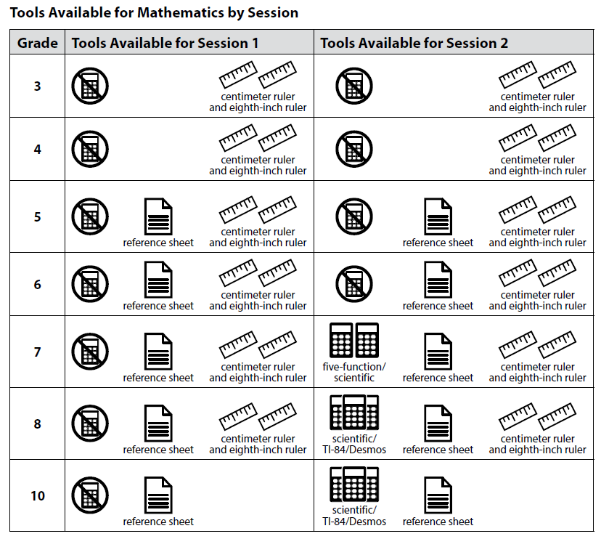
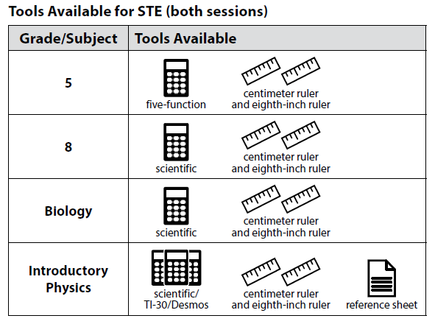
Prepare Materials that Your School Will Provide to Students
For the list of materials that are required or permitted for testing, and materials prohibited from testing, refer to the PAM beginning on page 21.

Slide 29
Go online to www.mcasservicecenter.com to complete the PCPA.
Principals must complete the PCPA to certify that the school has followed proper MCAS test security protocols.
See PAM page 61 (section I, step 3) for steps to complete the PCPAs.
  Note: The PCPA may not be completed by a designee.
Use your school’s 2024 password for the MCAS Service Center website to access the PCPA.
  Password letters are in DropBox Central in DESE’s Security Portal.
  See the Nov. 28 Student Assessment Update for details.
  Schools that do not find their password in their DropBox should email MCAS@mass.gov, and questions about completing the PCPA should be sent to mcas@cognia.org.
Deadline dates for submitting the PCPAs:
  Grades 3–8: May 28
  Grade 10 ELA and Math: May 30
  High school Science: June 13

Slide 30
Poll Question
As a principal or school test coordinator, who should you contact if you don’t have a PAN account?
  Another principal or test coordinator
  Technology coordinator
  Call the MCAS Service Center
  District test coordinator

Slide 31
CBT Technology Preparations
Meet with the technology coordinator to plan for set-up and troubleshooting during test administration.
  See PAM page 49 (section B, step 1), and Appendix A (page 65).
  Recommended steps:
    Review prior training sessions.
    Register for the Pre-Administration Tasks for Technology Staff session on February 5.
    Schedule one-on-one technology support prior to administration.
  Schedule district support techs for testing days, whenever possible.
  Prepare devices, hardware, and network settings
    Can use the Computer-based Testing Device Planner
    e.g., power strips, battery adapters, extension cords, extra devices for each testing area, external keyboards for tablets, headphones for text-to-speech accommodation

Slide 32
CBT Technology Preparations (cont’d)
Familiarize test administrators with tasks they will need to complete in PAN.
  List of modules and tasks to complete in PAN: PAM pages 37–38
  Instructions and troubleshooting steps: CBT TAM Appendix B
  If there is a technology situation in which a student is waiting more than 15–20 minutes, schedule the student to complete the session at another time, after calling the MCAS Service Center for support (800-737-5103).

Slide 33
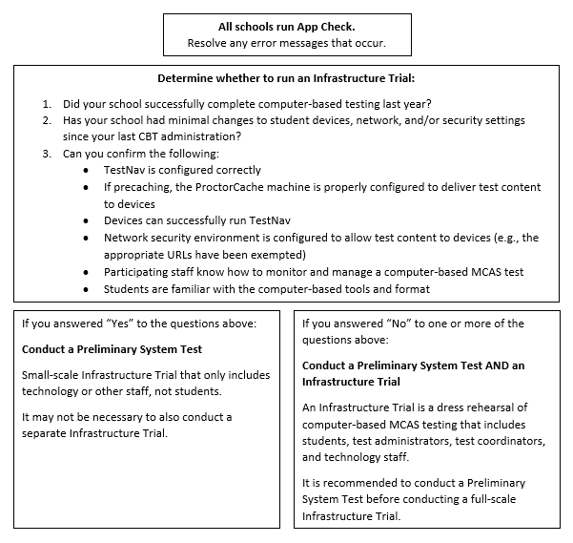
Network and Device Testing
Resources:
Infrastructure Trial Readiness Guide
Infrastructure Trial trainings slides and recordings

Slide 34
Steps to Complete During and After Testing
CBT tasks for principals/test coordinators will be discussed during upcoming trainings
  Tasks to complete during testing: beginning on PAM page 58
  Tasks to complete after testing: beginning on PAM page 60
Ask the district SIMS contact to update student data as necessary.
Be prepared to check preliminary data according to the reporting schedule, which will be provided in a spring edition of the Student Assessment Update.

Slide 35
Training Sessions on PAN
Date | Session | Audience
Tuesday, February 27 | Tasks in PAN Before Testing | Principals and test coordinators
Thursday, February 29 | PAN Tasks for Accessibility and Accommodations | Principals, MCAS test coordinators, special education administrators and supervisors, and test administrators administering accessibility features for all students and accommodations for students with disabilities and EL students
Tuesday, March 12 | Tasks in PAN During Testing | Principals and test coordinators, and test administrators
Thursday, March 14 | Tasks in PAN After Testing | Principals and test coordinators
Additional sessions offered for
  technology coordinators for test administration preparation,
  curriculum coordinators and teachers on constructed responses
Registration available at www.doe.mass.edu/mcas/training.html
About a week after each session, the recording and slides are posted at mcas.pearsonsupport.com/training/ for test administration sessions (slides for sessions on constructed responses will be on DESE website).

Slide 36

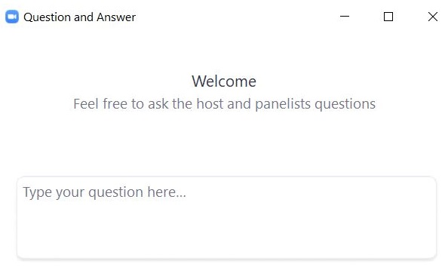
Questions and Answers
Use the “Q&A” feature to ask questions.

Slide 37
3. Test Security Requirements

Slide 38
Poll Question
Which of these are testing irregularities? (Select all that apply.)
  Cell phone use
  Text-to-speech on the ELA test for a student who has accommodation A4 in their IEP
  Accessing reference sheets or graphic organizers
  Calculator use on the grade 5 STE test
  Student communication (talking or passing notes)
  Copying another student’s work/answers
  Accessing the internet

Slide 39
The Framework for Test Security
Prevent
  The foundation of a test security plan is always prevention. Most issues can be anticipated and prevented.
Detect
  How do you detect incidents? By looking for them.
Investigate
  Gather all the facts you can.
Report
  Call DESE to report testing irregularities.

Slide 40
The Importance of Leadership
Teachers and students take their cues from above – leaders set the tone.
Superintendents
  should review their principals’ test security plans and be comfortable with the procedures in their buildings (PAM, page 3)
  are encouraged to visit their schools and observe testing
Principals
  must establish school-wide expectations for a proper test administration
  must ensure that test administrators are properly trained
  must ensure that MCAS protocols are being followed
  must ensure that accommodations are correctly given
  must sign the Principal’s Certification of Proper Test Administration (PCPA) and attest to a proper test administration

Slide 41
Poll Question
Which of the following materials are secure? (Select all that apply.)
  blank scratch paper
  student testing tickets
  reference sheets
  test & answer booklets
  used scratch paper
  proctor testing tickets

Slide 42
Secure Content and Materials for CBT
Secure content
  MCAS questions not publicly released by DESE
    including reading passages, diagrams, writing prompts and other information on testing screens and (for PBT) in testing booklets
  Student responses to test questions
Secure materials
  Student testing tickets and proctor testing tickets
  Used scratch paper after testing (until it is securely destroyed)
  Booklets containing test content or student responses (for PBT)

Slide 43
Confidentiality of Secure Test Content
Principals, test administrators, and others are prohibited from
  Viewing test content (on screens or in booklets)
  Duplicating or reproducing test content
    Technology staff may not take photographs of computer screens.
  Discussing test content with anyone before, during, or after testing
    Exception for a student reporting a concern about a test question

Slide 44
Exceptions to Prohibition of Test Administrators Viewing MCAS Content
Assisting a student with the computer interface during testing
Reading a word or phrase aloud on Mathematics or STE tests – Universal Accessibility Feature 11 (UF11)
  See page 103 of the PAM for the description of UF11
Administering certain accommodations (MCAS Nondisclosure Acknowledgment required)
  Accommodations A2, A3.1, A3.2, A3.3, A5, A6.1, A8, A10.1, A10.2, A11, A12, A13, A14, A15
  Special access accommodations SA1.2, SA2, SA3.1, SA3.2, SA6
  English learner accommodations EL3.2, EL4.1, EL4.2

Slide 45
If a Student Has a Concern about a Test Question
If a student reports a concern with a test question (e.g., the student thinks there is a flaw in the question or the student is uncomfortable with the content of the question for a nonacademic reason), the school should do the following:
  The test administrator should note the question number, the student’s form number*, and the nature of the concern.
  The test administrator should report the concern to the principal.
  The principal should report the concern to the Assessment office.
  School staff should refrain from discussing the content of the test question.
  See also page 36 of the PAM.
*For CBT, listed in the rightmost column of the “Students in Sessions” screen in PAN under the “Form” heading

Slide 46
Handling and Storage of Secure Materials
Store all secure materials in a secure central location.
  locked when tests are not being administered
  restricted access
Maintain chain of custody of materials during test administration.
  Internal tracking forms (www.doe.mass.edu/mcas/testadmin/forms)
  Independent counts of secure materials
  Do not leave materials unattended.

Slide 47
A Secure Testing Environment – Out of the Room
Students must be supervised when out of the testing room.
  e.g., using the restroom, visiting the nurse, moving to a test completion room or supervised lunch
A few options
  hallway monitors
  monitors stationed at restrooms with lines of sight to testing rooms
  staff who escort students to and from the restroom
Optional scripts in Test Administrator’s Manuals (TAMs) to read prior to
  the transition to a test completion room
  a supervised lunch break
  students visiting the restroom

Slide 48
A Secure Testing Environment – In the Room
Cover or remove prohibited classroom displays.
No unauthorized visitors in testing rooms
  parents, media, non-testing students
  teachers
Testing rooms may be entered by
  technology staff for troubleshooting
  school administrators
  district personnel
  DESE observers
When possible, use two test administrators in the room.

Slide 49
Secure Room Set-up for Computer-Based Testing
Students must not be able to view any screen but their own.
  Set up rooms in advance to test out different seating arrangements (e.g., spreading desks out, staggering students, turning students in different directions).
  Consider physical barriers (partitions, privacy screens, cardboard taped to the side of monitors).
  Have an administrator walk around at the start of testing and check all the rooms.

Slide 50
Prohibited Materials
Make sure students understand they are not allowed to have
  cell phones and other electronic devices (e.g., wireless ear buds, smartwatches)
  calculators on noncalculator tests and sessions
  notes or reference material beyond what they’re given, such as additional reference sheets, graphic organizers, multiplication grids (exceptions for certain accommodations)
  dictionaries
A poster showing examples of prohibited materials is available for download and printing
  www.doe.mass.edu/mcas/testadmin/forms/

Slide 51
Poll Question
How do you ensure students don’t have access to cell phones during testing? (Select all that apply.)
  Students put phones in backpacks and put backpacks to the side/back of the room.
  Phones are collected and kept at the front of the room with the test administrator.
  Phones are put in lockers and not allowed in the testing room.
  Students are not allowed to have phones in school.
  Student phones are locked away during the school day (e.g., in storage cases or Yondr bags).
  Other

Slide 52
Training Test Administrators and Other Personnel
All individuals involved in MCAS administration must participate in a school-provided training session.
  MCAS test security requirements (Part I of the PAM)
  MCAS test administration protocols (Part III of the PAM)
  School-specific procedures and logistics
Sample slides for training test administrators (to be posted soon)
  www.doe.mass.edu/mcas/testadmin

Slide 53
Training Test Administrators and Other Personnel – Documentation
Test administrators must sign forms to acknowledge the following:
  participation in training
  receipt of TAMs
    combined sample form
Test administrators who will administer certain accommodations to students with disabilities or ELs must sign an MCAS Nondisclosure Acknowledgment
  See page 21 of the CBT TAM, page 19 of the PBT TAM, or page 105 of the PAM for the list of accommodations this requirement applies to (also listed on slide 44).

Slide 54
Test Administrator Responsibilities
Test administrators must
  Maintain the chain of custody of secure materials.
  Make sure students have the correct materials for each session.
  Follow instructions in the TAMs and read scripts verbatim.
  Circulate throughout the room to prevent cheating and the use of prohibited materials – active proctoring.
  Focus their full attention on the testing room.
  Refrain from coaching students or influencing their responses in any way.

Slide 55
Poll Question
Which of the following are examples of coaching? (Select all that apply.)
  “Don't forget to use specific examples in your essay.”
  “You need to write more.”
  “Just do your best.”
  “Give your best effort.”
  “Remember what we talked about in class last week.”
  “You’ve got this.”

Slide 56
What is Coaching?
Providing hints or clues
  “Think about what we studied in class last week.” “What’s the acronym for order of operations?” “Consider it from the main character’s perspective.” “Don’t forget to use specific examples in your essay.”
Indicating in any way that a student has answered a question incorrectly:
  “You should look at that one again.”
  “Check your work” (to a specific student on a specific question)
Defining or spelling words
Explaining, simplifying, or paraphrasing any part of the test
Suggesting that a student write more
Influencing a student’s response through gestures, facial expressions, nods, body language, or changes in voice inflection

Slide 57
What is Permitted?
Assisting students with technology-related problems
  helping a student sign in to TestNav (this is the only situation in which a test administrator may type directly into a student’s test)
  pointing to a tool button if a student is unable to find it
  explaining to a student how to enter a result in the equation editor
  explaining how to navigate to a test question from the review screen
Re-reading part of the TAM script to students
  E.g., As students finish, can read script to students to check their work.
Encouraging students if they have questions about test content:
  “Just do your best.” “Just give your best effort.” “Do the best you can.”

Slide 58
Test Security Requirements for Students
Students’ results may be invalidated if they engage in any of the following activities:
  duplicating any portion of secure test content
  accessing prohibited materials such as cell phones or other electronic devices
  communicating with other students (e.g., talking, whispering, writing notes)
  looking at any other student’s computer screen or answer booklet
  asking for or receiving help from anyone (except for reporting a concern about a test question to a test administrator)
  providing help to another student
  consulting notes, books, or instructional materials during testing
  discussing test content with a student who hasn’t tested yet.
See sample form for students and a sample letter to send to parents (recommended for grades 6 and up) at www.doe.mass.edu/mcas/testadmin/forms

Slide 59
Poll Question
What should you do first if a testing irregularity happens at your school?
  Call DESE’s Office of Student Assessment Services.
  Call the MCAS Service Center.
  Contact the student’s parents/guardians.
  Email an irregularity report to DESE.

Slide 60
Change in Reporting Requirements for Certain Irregularities after Students Have Completed Their Tests
New for 2024, irregularities involving benign use of electronic devices after students have submitted their tests in TestNav (or turned in PBT materials) do not need to be reported to DESE.
These situations can be handled locally, with any school-based consequences at the discretion of the principal.
This is not a change to any of the policies on prohibited devices described in slide 50 and on pages 27–28 of the PAM – it is only a change in reporting requirements.
As always, schools can call DESE to consult.

Slide 61
Steps to Take after a Security Incident or Irregularity
Call DESE at 781-338-3625.
Investigate the incident.
  Talk to the test administrator(s) involved.
  Talk to any students involved.
  Collect documents (e.g., notes, extra reference sheets).
  If reporting a read-aloud violation, determine how much of the test was read.
  If reporting a calculator violation, determine which items were solved with the calculator.
Submit a report if instructed to.
Take any local action that is appropriate.

Slide 62
Questions and Answers
Use the “Q&A” feature to ask questions.

Slide 63
4. Accessibility and Accommodations

Slide 64
New for 2023–24 for Accessibility and Accommodations
Color contrast and answer masking no longer required in the SR/PNP
  All students will have access to these accessibility features in TestNav
Review Appendix A: PAN Guidance for Form-Dependent Accommodations of the Guide to the SR/PNP Process before assigning accommodations.
Anyone who signs in to TestNav with a proctor testing ticket for a human read-aloud or human signer edition will see a prompt onscreen asking to verify whether they are a student or test administrator.
  Designed to prevent students from entering responses with proctor testing ticket
Text-to-speech will appear differently for Grade 8 Civics Field Test than other subjects (see Civics accommodated practice tests)

Slide 65
Resources for Accessibility and Accommodations
Category | Resources
Test administration manuals | Appendix C of the Principal’s Administration Manual Appendices C, D, and E of the CBT Test Administrator’s Manual Appendices B–G of the PBT Test Administrator’s Manual
Other guidance materials | Accessibility and Accommodations Manual and other resources Procedures During Testing for Students with Diabetes Who Use a Cell Phone to Control a Continuous Glucose Monitor (CGM) or an Insulin Pump MCAS Resource Center Test Admin Resources page – click on “Accessibility and Accommodations Guidance” drop-down menu
Previous trainings and modules | Recordings and slides in the MCAS Resource Center on the Training page Accessibility and accommodations module January 18: Overview of the SR/PNP January 30 and February 1: MCAS Accessibility and Accommodations
Upcoming training session | PAN Tasks for Accessibility and Accommodations on Feb. 29 at 9:30 a.m. for Principals, MCAS test coordinators, special education administrators and supervisors, and test administrators administering accessibility features for all students and accommodations for students with disabilities and EL students

Slide 66
Participation of Students with Disabilities and EL Students
Students with disabilities
  Participate according to IEP or 504 plan
  Paper-based tests are available as an accommodation for students with disabilities who are unable to use a computer for testing.
English learners (ELs) are required to participate in MCAS or MCAS-Alt in all subjects required their grade.
  Exception: First-year ELs have option to participate in ELA testing for diagnostic purposes only.
  “First-year EL” is a student whose name does not appear in March 2023 SIMS.
  Paper-based tests available as an accommodation for first-year ELs unfamiliar with technology
  Bilingual word-to-word dictionaries available for current ELs and students who were ever EL.
See Appendix C of the PAM for more information.

Slide 67
MCAS Accessibility and Accommodations
Accessibility features available to all students:
  UFs – Universal Accessibility Features (may differ, depending on CBT or PBT)
  DFs – Designated Accessibility Features (at discretion of principal)
Accommodations available only for students with disabilities and ELs
  Standard and Special Access accommodations for students with disabilities
  Accommodations for ELs, with guidance based on English proficiency level
Must select the accessibility features and accommodations in SR/PNP if listed with an “SR/PNP” prior to test administration.
  e.g., text-to-speech - TTS, large print, paper, Braille
  See list of accessibility features and accommodations in Appendix E of the Accessibility and Accommodations Manual.
Test administrators administering accommodations must receive additional training on procedures for these accommodations.

Slide 68
Test Preparation
Students should:
  Become familiar with features and basic functionality of TestNav.
  Take online practice tests prior to test administration.
  Review student tutorial at http://mcas.pearsonsupport.com/.
Schools should:
  Plan for testing students with accommodations.
  Schedule testing locations, test administrators, and testing time.
  Set up specialized computers/Assistive Technology (AT) after reviewing IEPs, 504 plans, and local EL accommodations forms.
  Plan to monitor accommodations.

Slide 69
Important Reminders for CBT
Test administrators for Human Read-Aloud and Human Signer accommodations will use their own computer and sign in with a proctor testing ticket to access a “test administrator” test edition.
  A separate PAN Session must be created.
  Responses are not saved when using a proctor testing ticket.

Slide 70
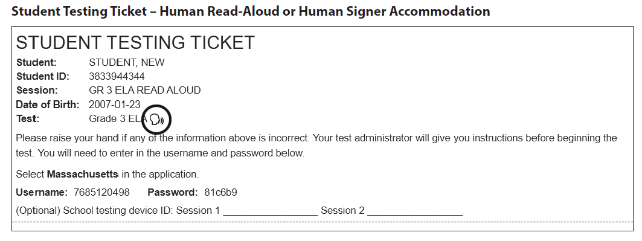
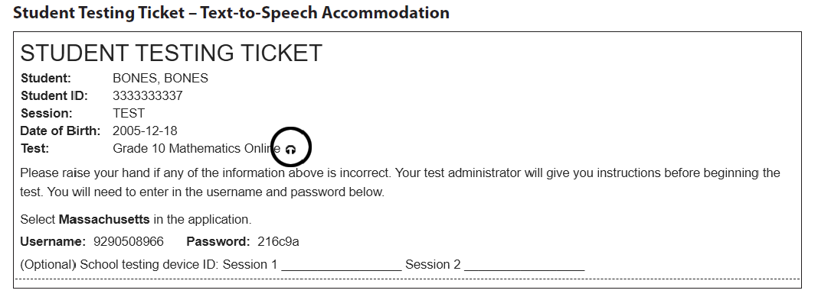
Student Testing Tickets for Human Read-Aloud, Human Signer, TTS

Slide 71
Prohibitions for Accommodations
Test administrators may NOT:
Students’ results may be invalidated for these situations:
Provide accommodations not listed in
  a student’s IEP or 504 plan
  Appendix C of the PAM, without prior DESE approval
Provide a student with a modified version of a test or a test for a different grade.
Coach or assist a student with their responses
  E.g., “Write more” or “Go back and review”
  Provide clues/assistance/definitions
Using an English-language dictionary for ELA
Reading aloud the ELA test to a student who does not have this Special Access accommodation in their IEP
Giving a calculator on noncalculator session of the Mathematics test to a student who does not have this Special Access accommodation in their IEP
Test administrator coaching or assisting a student

Slide 72
Questions and Answers
Use the “Q&A” feature to ask questions.

Slide 73
5. Resources, Support, and
Next Steps

Slide 74
Additional Resources
Resource | Description
ELA | Mathematics | STE | Civics | Test designs
Sample materials from schools | Locally developed test administration materials from schools/districts
Cybersecurity information | Guidance on cybersecurity
Civics field test | Administration resources for the Civics field test

Slide 75
Next Steps
Today: Complete the evaluation form.
  Responses are associated with the name and email address used to log in.
  Email your input to MCAS@mass.gov if you have problems accessing or completing the form.
Within one week:
  Receive an email with the Q&A from this session
  Recording will be available

Slide 76
Email and Phone Support
MCAS Service Center
DESE Student Assessment Services
Questions on logistics and technology (e.g., PearsonAccess Next, SR/PNP, TestNav)
  Web: mcas.pearsonsupport.com
  Email: mcas@cognia.org
  Phone: 800-737-5103
  Schedule Technology Support Call
Policy questions (e.g., student participation, accommodations, “I have a student who…”)
  Web: www.doe.mass.edu/mcas
  Email: MCAS@mass.gov
  Phone: 781-338-3625

Slide 77
6. Protocols for PBT
- Accommodations A1 and EL1 for
Grades 3–8 and 10, and High School Science

Slide 78
Booklets for Spring 2024
Grades/Subjects | Type of booklets | # of booklets and description
Grades 3–8 tests | Combined test & answer booklets | One booklet per subject (both sessions for each subject in a single booklet)
Grade 10 ELA and Mathematics, Biology and Introductory Physics | Combined test & answer booklets | One booklet per session (two booklets total)
Spanish/English editions (grade 10 Mathematics, Biology, Introductory Physics) | Separate test booklets and answer booklets | One test booklet for each session, and one answer booklet for each session (four booklets total)
Secure PBT materials include these booklets, test questions not publicly released by DESE, and student responses.

Slide 79
Receive Test Materials and Prepare for Distribution
Account for secure materials using ID #s on packing slips and document the counts on internal tracking forms and Materials Summary.
  DESE recommends having 2 people present to count materials upon receipt.
Affix Student ID Labels to answer booklets before testing (2024 manuals state this should be done by adults, not students).
  Labels based on SIMS/SIF as well as SR/PNP updates
  Can open packages of answer booklets up to two days prior to apply labels
  Can open packages of test & answer booklets one day prior to apply labels, and then seal in envelopes until the day of testing. Document the count on the envelopes.
  See PAM page 91, step 5.

Slide 80
Order Materials for Newly Enrolled Students
A small overage is shipped to schools; check your shipment to determine if you have extra materials.
Order additional materials if the overage doesn’t cover your testing needs: www.mcasservicecenter.com
Materials are shipped for receipt on the following business day if the order is received before 12:00 p.m. (two business days otherwise).
Remember to update the SR/PNP.

Slide 81
Additional Preparations for PBT
Additional resources for preparing students
  Released PBT questions
    www.doe.mass.edu/mcas/release.html
  Gridded response guidelines for Mathematics
    mcas.pearsonsupport.com/student
PBT edition of the student questionnaire
Tools available for students taking Mathematics and STE
  Lists on pages 85–87 of the PAM

Slide 82
Steps During and After Testing for PBT
After each test session, verify that all materials have been returned to you.
  Independently count materials after test administrator counts materials.
Double-check central storage area.
  In the bottom of a bin and in between file folders
Find original shipping cartons to return materials.
See the PAM for packing instructions and lists of materials for school files, to recycle/discard, and to securely destroy.

Slide 83
Important Reminders for Packing PBT Materials
Review “Special Instructions” included with Braille, and large-print materials to avoid problems with scoring.
Review tables in the PAM on pages 93 and 94 to determine whether to assign booklets for students, and instructions on student information on booklet covers.
If necessary, return the following materials in the Special Handling Envelope:
  All large-print booklets, along with corresponding standard booklets with transcribed work
  Typed responses, printed and slipped inside standard booklets (see pages 122–124 of the PAM for the header information for each page).
If necessary, return booklets that should not be scored in the Void Envelope.
  Fill in “void booklet” circle on outside back cover (follow transcription instructions if needed).
Return all other used and unused booklets (except for Braille) in the Return Envelope marked with the corresponding subject.
All materials will be shipped back to the contractor in their original packing cartons.

Slide 84
The Return Shipment
Complete the Materials Summary and retain it for school files.
  Reconcile quantities of secure materials received vs. returned.
Maintain security of materials while preparing for pickup.
  Use correct UPS labels.
  Do not take materials to UPS or remove from building.
  Do not leave materials unattended.
Prescheduled automatic pickups
  A UPS driver will automatically come to the school on the pickup deadline date for each administration. Schedule earlier pickup if ready.
    Grades 3–8 ELA: April 30; Grades 3–8 Math/STE: May 29
    Grade 10 ELA: April 8
    Grade 10 Mathematics: May 31
    High School Science: June 14

Slide 85
Questions and Answers
Use the “Q&A” feature to ask questions.

Slide 86
7. Competency Determination Graduation Requirements

Slide 87
Competency Determination (CD) graduation requirements differ by class.
Interim CD for ELA, Mathematics, and STE for the Classes of 2024 and 2025
  The passing standard for the classes of 2024 and 2025 are set at a level of achievement that has been established as equivalent to the standard on the legacy MCAS tests.
  Some students may score in the Not Meeting Expectations level, but their scaled score is high enough to earn the CD in that subject.
    See the Sept. 22, 2022 edition of the Student Assessment Update for a visual representation of this.
www.doe.mass.edu/mcas/graduation.html

Slide 88
CD Requirements for the Classes of 2024 and 2025
Subject | Option 1 | Option 2
ELA | Earn a score of 472 or higher | Earn a score of 455–471 and Fulfill the requirements of an Educational Proficiency Plan
Math | Earn a score of 486 or higher | Earn a score of 469–485 and Fulfill the requirements of an Educational Proficiency Plan
STE | Earn a score of 220 or higher on legacy Chemistry or Technology/Engineering, or the interim passing standard for next-generation Biology (467) or Introductory Physics (470) | Not applicable (only one option for STE)
A note on the passing standard:
The passing standards for the classes of 2021–2025 are set at a level of achievement that has been established as equivalent to the standard on the legacy MCAS tests (see the Sept. 22, 2022 edition of the Student Assessment Update).

Slide 89
CD Requirements for the Classes of 2026–2030
Subject | Option 1 | Option 2
ELA | Earn a score of 486 or higher | Earn a score of 470–485 and Fulfill the requirements of an Educational Proficiency Plan
Math | Earn a score of 486 or higher | Earn a score of 470–485 and Fulfill the requirements of an Educational Proficiency Plan
STE | Earn a score of 470 or higher on high school Science (Biology or Introductory Physics) | Not applicable (only one option for STE)

Slide 90
Questions and Answers
Use the “Q&A” feature to ask questions.

Slide 91




THANK YOU
The Office of Student Assessment Services
781-338-3625
MCAS@mass.gov
www.doe.mass.edu/mcas
135 Santilli Highway, Everett, MA 02149

